Slide 1
REAL TIME FACE MASK DETECTION
DONE BY:-
ATHAR IMAM / 1026
DHRUV RAJ / 1049

Slide 2
AGENDA
INTRODUCTION OF THE PROJECT
ABSTRACT
PROBLEM DEFINATION
PROBLEM STATEMENT
LITERATURE SURVEY
REQUIREMENT ANALYSIS ( EXISTING / PROPOSED SYSTEM )
DESIGN( UML DIAGRAMS / ARCHITECTURE )

Slide 3
INTRODUCTION OF THE PROJECT
During pandemic COVID-19, WHO has made wearing masks compulsory to protect against this deadly virus. In this project we will develop a machine learning project – Real-time Face Mask Detector with Python.
We will build a real-time system to detect whether the person on the webcam is wearing a mask or not. We will train the face mask detector model using Keras and OpenCV.

Slide 4
Abstract
Effective strategies to restrain COVID-19 pandemic need high attention to mitigate negatively impacted communal health and global economy.
The end of 2019 witnessed the outbreak of Coronavirus Disease 2019 (COVID-19), which has continued to be the cause of plight for millions of lives and businesses even in 2022. As the world recovers from the pandemic and plans to return to a state of normalcy, there is a wave of anxiety among all individuals, especially those who intend to resume in person activity.
Studies have proved that wearing a face mask significantly reduces the risk of viral transmission as well as provides a sense of protection. However, it is not feasible to manually track the implementation of this policy. Technology holds the key here.
We introduce a Deep Learning based system that can detect instances where face masks are not used properly. Our system consists of a dual stage Convolutional Neural Network (CNN) architecture capable of detecting masked and unmasked faces and can be integrated with pre-installed CCTV cameras. This will help track safety violations, promote the use of face masks, and ensure a safe working environment.
Keywords: Deep Learning, Computer Vision, OpenCV, TensorFlow, Keras.

Slide 5
PROBLEM DEFINATION
The problems encountered with this approach include high complexity in feature design and low detection accuracy.
In recent years, face detection methods based on deep convolutional neural networks (CNN) have been widely developed to improve detection performance.

Slide 6
PROBLEM STATEMENT
The task here is to predict people wearing masks or not wearing them, given an image or a video.
It is an object detection and classification problem with 2 different classes(Mask and Without Mask).

Slide 7
REQUIREMENT ANALYSIS
Face Mask Detection Platform currently depends on human moderators to recognize if a user is wearing a mask or not.
Face Mask Detection is done by using humans and guards at many places to detect people without masks.
However, it is not feasible to manually track the implementation of this policy.

Slide 8
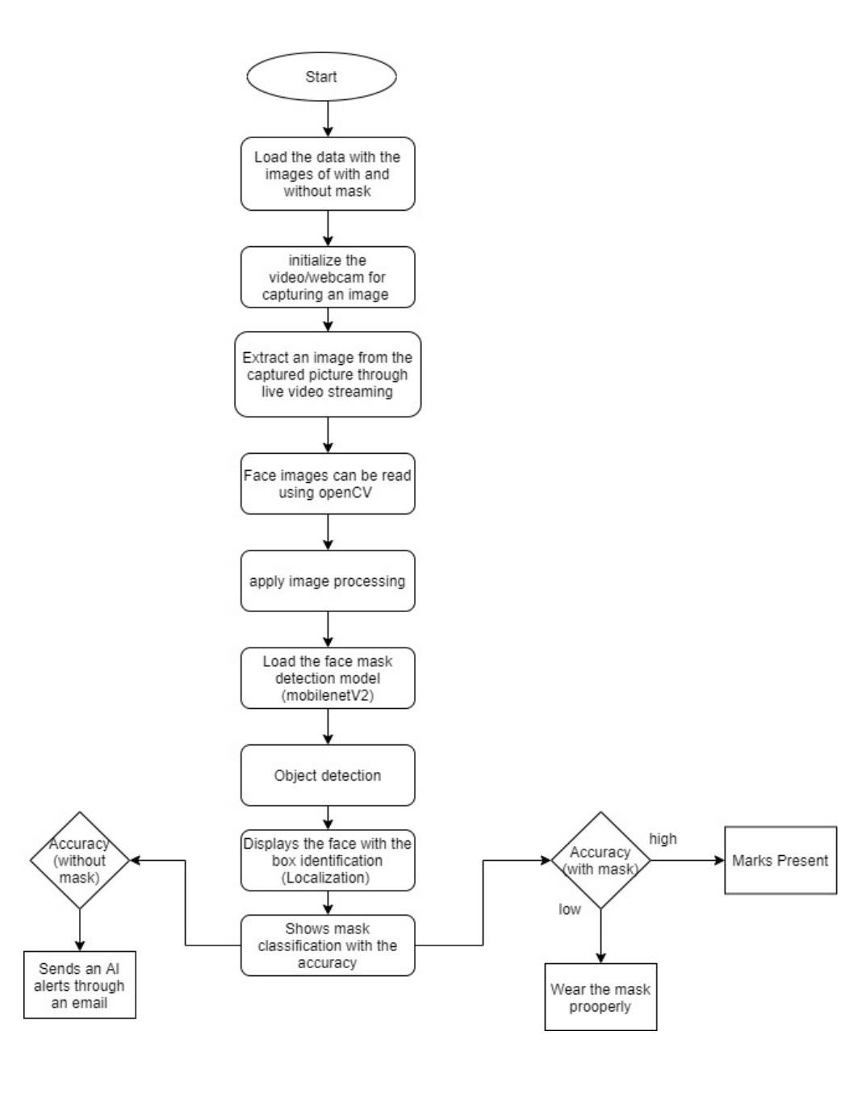
DESIGN

Slide 9
.
THANK YOU
.

